Slide 1
Non-projective Dependency Parsing using Spanning Tree Algorithms Ryan McDonald, Fernando Pereira
Group 6
Aashika Shetty, Kedar Deshpande, Shruti Sharan, Vidhu Malik

Slide 2
Syntax and Semantics
“Colorless green ideas sleep furiously” - Chomsky
Notes:
https://slideplayer.com/slide/6623811/

Slide 3
Syntax and Semantics
“Colorless green ideas sleep furiously” - Chomsky
Looks incorrect

Slide 4
Syntax and Semantics
“Colorless green ideas sleep furiously” - Chomsky
Looks incorrect
But something looks right

Slide 5
Syntax and Semantics
“Colorless green ideas sleep furiously” - Chomsky
Looks incorrect
But something looks right
Problem: Representing the syntax of languages

Slide 6
Lexical Categories
Popularly called “parts of speech”
Noun
Adjective
Verb
Adverb
Pronoun
Determiner
Adposition

Slide 7
Representing Language
How do we incorporate the rules?

Slide 8
Representing Language
How do we incorporate the rules?
Grammar

Slide 9

Grammar
Also called phrase structure rules

Slide 10
Grammar
Also called phrase structure rules
S ⇒ NP VP

Slide 11
Grammar
Also called phrase structure rules
S ⇒ NP VP
NP ⇒ (det) (adj) N (PP)

Slide 12
Grammar
Also called phrase structure rules
S ⇒ NP VP
NP ⇒ (det) (adj) N (PP)
PP ⇒ P NP

Slide 13
Grammar
Also called phrase structure rules
S ⇒ NP VP
NP ⇒ (det) (adj) N (PP)
PP ⇒ P NP
VP ⇒ V (NP) (PP) (Adv)**

Slide 14
Grammar
Also called phrase structure rules
S ⇒ NP VP
NP ⇒ (det) (adj) N (PP)
PP ⇒ P NP
VP ⇒ V (NP) (PP) (Adv)**
Not a global grammar set

Slide 15
Phrase structure Trees
How do we use this grammar to represent sentences now?
S ⇒ NP VP
NP ⇒ (det) (adj) N (PP)
PP ⇒ P NP
VP ⇒ V (NP) (PP) (Adv)**

Slide 16
Phrase structure Trees
How do we use this grammar to represent sentences now?
Top down tree diagram
S ⇒ NP VP
NP ⇒ (det) (adj) N (PP)
PP ⇒ P NP
VP ⇒ V (NP) (PP) (Adv)**

Slide 17
Phrase structure Trees
He left quickly
S ⇒ NP VP
NP ⇒ (det) (adj) N (PP)
PP ⇒ P NP
VP ⇒ V (NP) (PP) (Adv)**

Slide 18
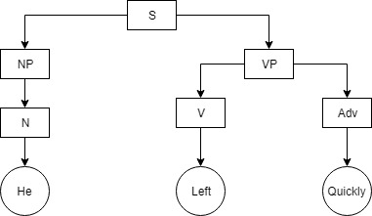
Phrase structure Trees
He left quickly
S ⇒ NP VP
NP ⇒ (det) (adj) N (PP)
PP ⇒ P NP
VP ⇒ V (NP) (PP) (Adv)**

Slide 19
Phrase structure Trees
The big man left quickly
S ⇒ NP VP
NP ⇒ (det) (adj) N (PP)
PP ⇒ P NP
VP ⇒ V (NP) (PP) (Adv)**

Slide 20
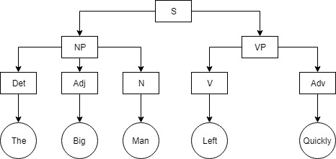
Phrase structure Trees
The big man left quickly
S ⇒ NP VP
NP ⇒ (det) (adj) N (PP)
PP ⇒ P NP
VP ⇒ V (NP) (PP) (Adv)**

Slide 21
Phrase structure Trees
John hit the ball with the bat
S ⇒ NP VP
NP ⇒ (det) (adj) N (PP)
PP ⇒ P NP
VP ⇒ V (NP) (PP) (Adv)**

Slide 22
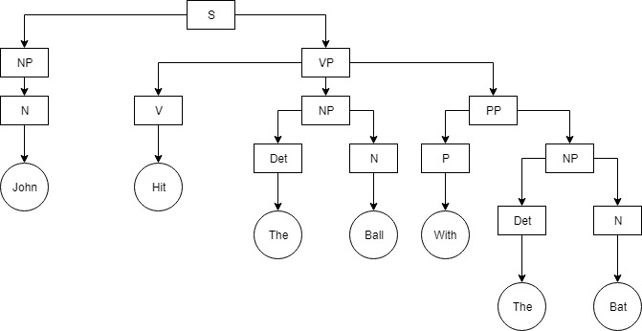
Phrase structure Trees
John hit the ball with the bat
S ⇒ NP VP
NP ⇒ (det) (adj) N (PP)
PP ⇒ P NP
VP ⇒ V (NP) (PP) (Adv)**

Slide 23
Issues with CFG
Global rule structure, Seems perfect for representing syntax

Slide 24
Issues with CFG
Global rule structure, Seems perfect for representing syntax NOT TRUE

Slide 25
Issues with CFG
Global rule structure, Seems perfect for representing syntax NOT TRUE
Reusability is low, everybody has their own grammar

Slide 26
Issues with CFG
Global rule structure, Seems perfect for representing syntax NOT TRUE
Reusability is low, everybody has their own grammar
Cannot build on top of this

Slide 27
Issues with CFG
Global rule structure, Seems perfect for representing syntax NOT TRUE
Reusability is low, everybody has their own grammar
Cannot build on top of this
Cannot represent all flexible language structures

Slide 28
Issues with CFG
Global rule structure, Seems perfect for representing syntax NOT TRUE
Reusability is low, everybody has their own grammar
Cannot build on top of this
Cannot represent all flexible language structures
Cannot be used for evaluating systems

Slide 29
Alternate linguistic structure
Defined by relationships between words
Relations among the words are illustrated with directed, labeled arcs from heads to dependents
Head
a word that governs
Dependent
a word that modifies
Labels
Dependency Relations

Slide 30
Alternate linguistic structure
I prefer the morning flight through Denver
EXAMPLE

Slide 31
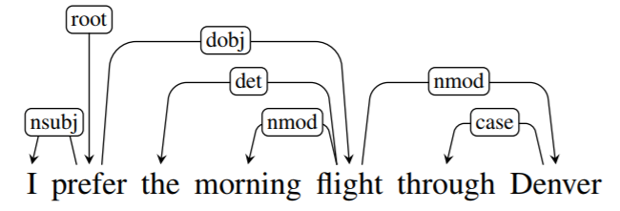
Dependency Structure

Slide 32
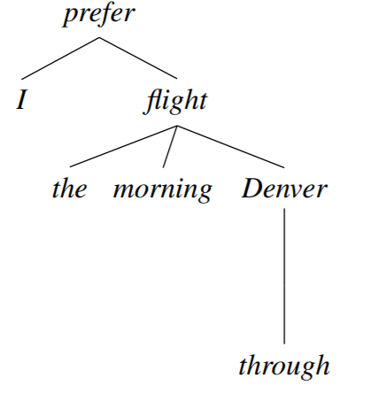
Dependency TrEe

Slide 33
Alternate linguistic structure
John hit the ball with the bat
ADDITIONAL
EXAMPLE

Slide 34
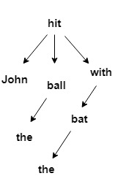
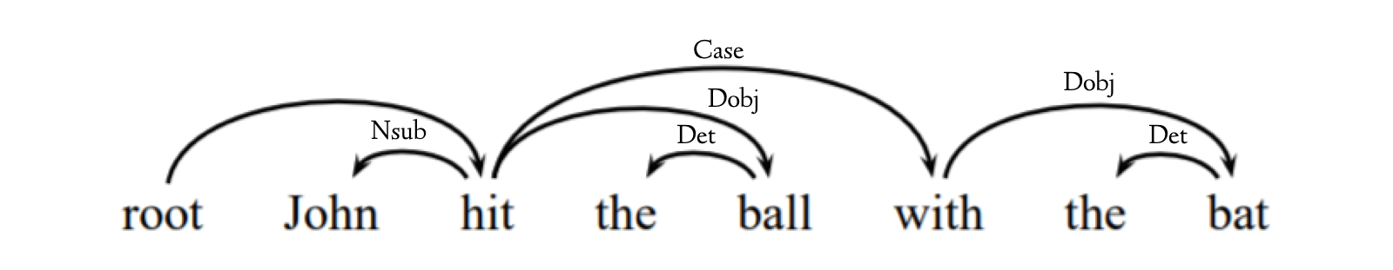
ADDITIONAL EXAMPLE Dependency Structure & DEPENDENCY TREE

Slide 35
Definition: Dependency Tree
A dependency tree is a directed graph that satisfies the following constraints:
There is a single designated root node that has no incoming arcs.
With the exception of the root node, each vertex has exactly one incoming arc.
There is a unique path from the root node to each vertex in V.

Slide 36
Dependency Grammar
A class of modern grammatical theories that are all based on the dependency relation (as opposed to the relation of phrase structure)
Dependency is the notion that linguistic units, e.g. words, are connected to each other by directed links
Dependency grammar approach abstracts away from word-order information, representing only the information that is necessary for the parse

Slide 37
Comparing phrase structure to dependency structure

Slide 38
Advantages of Dependency Grammar over CFG
Flatter structure, lesser phrasal nodes
Works with languages of flexible word order: Multilingual topology
Dependency relations are close to semantic relationships
Very reusable, can build other models on top of this
Used for evaluation (Example: the Prague dependency treebank)
This makes them directly useful for many applications such as:
question answering
information extraction
coreference resolution
Notes:
Used for evaluation (Example: the Prague dependency treebank)
Provides the frequency and distribution of various kinds of sentence that may exist
Multilingual topology
This makes them directly useful for many applications such as:
question answering
information extraction
coreference resolution

Slide 39
Another Example of a Dependency Tree
JetBlue canceled our flight this morning which was already late

Slide 40
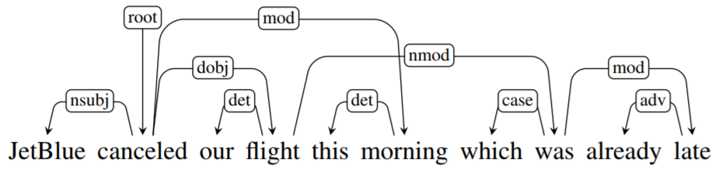
ANOTHER EXAMPLE OF A Dependency Structure

Slide 41

Dependency Tree Types
Projective Dependency Trees
Do not have crossing arcs
Non-projective Dependency Trees
Contain crossing arcs
Notes:
Types of dep define both here

Slide 42
Dependency Tree Types
Previous Examples: projective dependency trees
Non Projective Dependency: Includes crossing edges
Flexible word order (German, Dutch and Czech) = Frequent non-projective dependencies
Notes:
Types of dep define both here

Slide 43
The Dependency Parsing Problem
Parsing problem is intuitive to humans
Very difficult for computers
Computers cannot detect best relationships/dependencies between words
Notes:
Problem of analyzing a text to produce a grammatical structure with respect to a dependency grammar (word-word relation)
Dependency grammars are distinct from phrase structure grammars (constituency grammars) because they lack phrasal nodes
Application in NLP and NLU

Slide 44
Eisner Algorithm
Introduced in 1996
Solves the Dependency Parsing Problem
Data-structure: spans (complete and incomplete)
Approach: Dynamic Programming
Complexity: O(n³)
Algorithm: Bottom-up
Combine adjacent spans into a larger span
Usage of the highest scoring combination

Slide 45
Back to the Dependency Parsing Problem
Eisner algorithm: Only for projective dependency trees
How do we model the Dependency Problem for non-projective dependency trees?
Notes:
Let us think of a data structure to represent the information that is given to us before we devise an algorithm

Slide 46
Model as a Graph
Input sentence: x₁, . . . , x_{n} (words)
Modeled as a graph, each word represented as a node
Every pair of nodes has an edge with a score (Given by an Oracle function)

Slide 47


Mathematical Representation: Edge Factorization
For each sentence x, we construct a directed graph
Where, the vertices and edges are defined as follows:

Slide 48


Intuitive Algorithm
Given a fully connected graph with each edge having a score, we need to find the maximum score possible.
i.e. given
we try to find
Any ideas on which algorithm can be used to solve this problem, given the graph data structure that we have?

Slide 49
Crux of this Paper
“Dependency tree for a given sentence x and spanning tree for its equivalent directed graph G_{x} coincide”
Notes:
Since both trees are required to be rooted at the dummy root and reach all the words.

Slide 50
Crux of this Paper
“Dependency tree for a given sentence x and spanning tree for its equivalent directed graph G_{x} coincide”
Therefore, finding a dependency tree with highest score is equivalent to finding the maximum spanning tree in G_{x}
Notes:
Since both trees are required to be rooted at the dummy root and reach all the words.

Slide 51
ChU LIU EDMOND’s ALGORITHM

Slide 52
CHU LIU EDMOND’s ALGORITHM
Gx is a graph with –
The sentence words and the dummy root symbol as vertices
A directed edge between every pair of distinct words
A directed edge from the root symbol to every word
Notes:
Gx is a graph with
The sentence words and the dummy root symbol as vertices
A directed edge between every pair of distinct words
A directed edge from the root symbol to every word.

Slide 53
Chu Liu Edmond’s Algorithm
Step 1: We build the directed graph with the given edge weights.

Slide 54
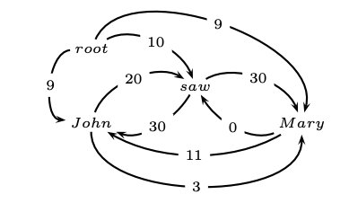
Chu Liu Edmond’s Algorithm
Step 1: We build the directed graph with the given edge weights.

Slide 55
Chu Liu Edmond’s Algorithm
Step 2: Find the highest scoring incoming edge for each word.
If this is a tree, we have found our MST.

Slide 56
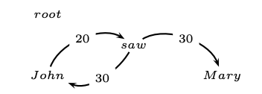
Chu Liu Edmond’s Algorithm
Step 2: Find the highest scoring incoming edge for each word.
If this is a tree, we have found our MST.

Slide 57
Chu Liu Edmond’s Algorithm
Step 3: Contract the cycle into a single node and recalculate the edge weights
Outgoing edges: Max of the outgoing arcs over all vertices in the cycle.
Incoming Edges: Equal to the best spanning tree that includes head of the incoming arc and all the nodes in the cycle.

Slide 58
Chu Liu Edmond’s Algorithm
Outgoing edge : Node to Mary
John ⇒ Mary = 3
Saw ⇒ Mary = 30

Slide 59
Chu Liu Edmond’s Algorithm
Outgoing edge : Node to Mary
John ⇒ Mary = 3
Saw ⇒ Mary = 30
Incoming edge: Root to Node
Root ⇒John ⇒ Saw = 9+20 = 29
Root⇒ Saw⇒John= 10+30 = 40

Slide 60
Chu Liu Edmond’s Algorithm
Outgoing edge : Node to Mary
John ⇒ Mary = 3
Saw ⇒ Mary = 30
Incoming edge: Root to Node
Root ⇒John ⇒ Saw = 9+20 = 29
Root⇒ Saw⇒John= 10+30 = 40
Incoming edge: Mary to Node
Mary ⇒ John ⇒ Saw = 11+20 = 31
Mary ⇒ Saw ⇒ John = 0+30 = 30

Slide 61
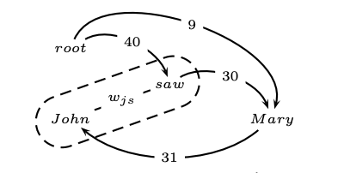
Chu Liu Edmond’s Algorithm
Outgoing edge : Node to Mary
John ⇒ Mary = 3
Saw ⇒ Mary = 30
Incoming edge: Root to Node
Root ⇒John ⇒ Saw = 9+20 = 29
Root⇒ Saw⇒John= 10+30 = 40
Incoming edge: Mary to Node
Mary ⇒ John ⇒ Saw = 11+20 = 31
Mary ⇒ Saw ⇒ John = 0+30 = 30

Slide 62
Chu Liu Edmond’s Algorithm
Step 4: Now we apply the Chu Liu_Edmond algorithm again, on the contracted graph:
Select the incoming edge with the maximum weight.
We have a maximum spanning tree! (YAY!)

Slide 63
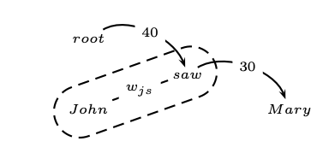
Chu Liu Edmond’s Algorithm
Step 4: Now we apply the Chu Liu_Edmond algorithm again, on the contracted graph:
Select the incoming edge with the maximum weight.
We have a maximum spanning tree! (YAY!)

Slide 64
Chu Liu Edmond’s Algorithm
Step 5: (For reconstruction) we go back one step recursive call and see how we constructed the connections to get back the original graph
Outgoing edge:
Saw ⇒ Mary =30
Incoming edge:
Root ⇒ Saw ⇒ John
Root ⇒ Saw = 10
Saw ⇒ John = 30
Thus we reconstruct the tree => Maximum Spanning Tree => Dependency Graph

Slide 65
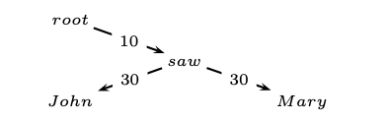
Chu Liu Edmond’s Algorithm
Step 5: (For reconstruction) we go back one step recursive call and see how we constructed the connections to get back the original graph
Outgoing edge:
Saw ⇒ Mary =30
Incoming edge:
Root ⇒ Saw ⇒ John
Root ⇒ Saw = 10
Saw ⇒ John = 30
Thus we reconstruct the tree => Maximum Spanning Tree => Dependency Graph

Slide 66
Chu Liu Edmond’s Algorithm
Each vertex in the graph greedily selects the incoming edge with the highest weight
If a tree results, it must be a maximum spanning tree
If not, there must be a cycle
Identify the cycle and contract it into a single vertex
Recalculate edge weights going into and out of the cycle

Slide 67
Need for a Learning Algorithm
Edges are associated with “feature vectors” and “weights”

Slide 68
Need for a Learning Algorithm
Edges are associated with “feature vectors” and “weights”
Feature Vectors are based on the nodes being connected and the label associated
Notes:
Feature vector: Composed of several attributes –
Number of words between head word and dependent
Length and direction of dependency
POS bigram features
Head and dependent word and POS separately

Slide 69
Need for a Learning Algorithm
Edges are associated with “feature vectors” and “weights”
Feature Vectors are based on the nodes being connected and the label associated
Weights need to be learned

Slide 70
Need for a Learning Algorithm
Edges are associated with “feature vectors” and “weights”
Feature Vectors are based on the nodes being connected and the label associated
Weights need to be learned
What weights will help find the best spanning tree?

Slide 71
MIRA: The Online Learning Algorithm
Supervised Learning Algorithm
Training set: (x,y) where x = sentence and y= correct dependency tree
Dt(x) are the possible dependency tree space associated with x
Need to learn “edge weights” that give the best dependency tree
Notes:
Current training example classified with margin against incorrect classifications atleast as large as their loss. Therefore change of parameters kept as small as possible

Slide 72
MIRA: The Online Learning Algorithm
Parameters updated for each training sample
Choose an update size that fixes the current mistake but also doesn’t significantly change the weight
Can be modelled as an optimization problem
Correct label should have a higher score
Loss: number of words with incorrect parents relative to the correct tree
Notes:
Current training example classified with margin against incorrect classifications atleast as large as their loss. Therefore change of parameters kept as small as possible

Slide 73
MIRA: Updated
Computationally intensive (Exponential blow up)
Single Best MIRA
Relaxed Constraint
Can be extended to k-best
Factored MIRA
Removal of Loss
Seperation with Margin of size 1 between weights of correct incoming edge and all other incoming edges
Correct and all incorrect spanning tree seperated by a score as large as atleast the number of incoming edges

Slide 74
Experiments
Czeck POS Tagging with Czeck Dependency Bank
More flexible word order, lots of non projective dependencies
Additional Optional tags: Gender, Case

Slide 75
Results
Metrics
Accuracy: Words that correctly identified their parents
Completeness: Number of sentences in which the resulting tree was completely correct

Slide 76
Results
Metrics
Accuracy: Words that correctly identified their parents
Completeness: Number of sentences in which the resulting tree was completely correct
Datasets with non-projective dependency perform better

Slide 77
Results
Metrics
Accuracy: Words that correctly identified their parents
Completeness: Number of sentences in which the resulting tree was completely correct
Datasets with non-projective dependency perform better
Complexities: Chu Liu Edmond (O(n^2)) and Eisner (O(n^3))

Slide 78
Results
Metrics
Accuracy: Words that correctly identified their parents
Completeness: Number of sentences in which the resulting tree was completely correct
Datasets with non-projective dependency perform better
Complexities: Chu Liu Edmond (O(n^2)) and Eisner (O(n^3))
Chu Liu Edmond's might seem like an overkill: MIRA simplifies it significantly

Slide 79
Results
Metrics
Accuracy: Words that correctly identified their parents
Completeness: Number of sentences in which the resulting tree was completely correct
Datasets with non-projective dependency perform better
Complexities: Chu Liu Edmond (O(n^2)) and Eisner (O(n^3))
Chu Liu Edmond's might seem like an overkill: MIRA simplifies it significantly
But Chu Liu Edmond's performs worse on datasets with only projective dependencies

Slide 80
Results
Metrics
Accuracy: Words that correctly identified their parents
Completeness: Number of sentences in which the resulting tree was completely correct
Datasets with non-projective dependency perform better
Complexities: Chu Liu Edmond (O(n^2)) and Eisner (O(n^3))
Chu Liu Edmond's might seem like an overkill: MIRA simplifies it significantly
But Chu Liu Edmond's performs worse on datasets with only projective dependencies
Factored MIRA >>> Single Best MIRA

Slide 81
Summary
Equivalence of dependency trees and maximum spanning trees
Parsing: Eisner’s or Chu Liu Edmond’s
Learning: MIRA
Unlike previous models, Non projective is the simpler solution

Slide 82
THANK YOU

